Slide 1
Identity and Access Management Transformation
March 22, 2022
John Moore
Leader – Identity and Access Management

Slide 2

Why Do We Need the Change
Current IAM Landscape
Post TSA Landscape
What’s Changing
What About All These IDs?
Timeline of the Work

Slide 3

Why Kyndryl Needs this Change
Must exit TSA by Nov 1, 2023
Mixture of IBM and Kyndryl infrastructure
Enterprise Directory Centric architecture
Need to integrate different tools
2-5 days to have new ID’s provisioned
Unknown # of exploiters prohibits transformation
Very expensive and complex to maintain
ISV has platform stability problems
Missing several business functions to transform our platform

Slide 4
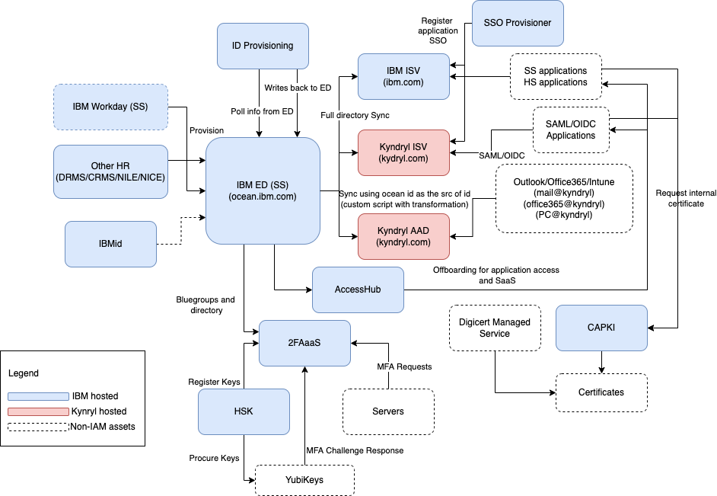
Identity & Access Management Environment
Current Landscape

Slide 5
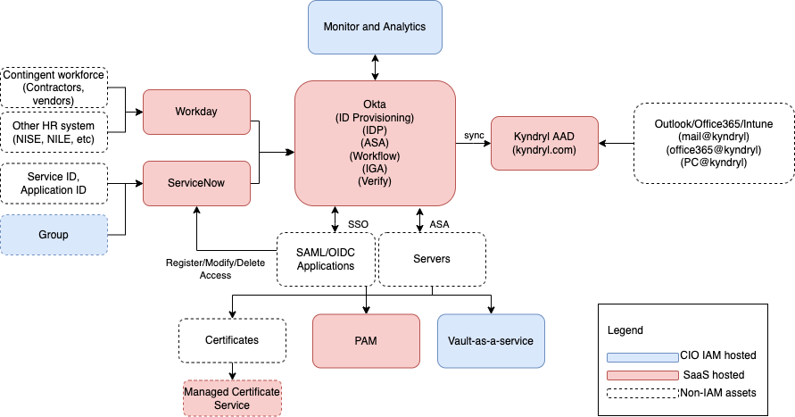
Identity & Access Management Environment
Post TSA Landscape
No longer dependent on IBM
Cloud based Identity Service (leveraging Okta)
Consolidate many scaffolding tools to perform IAM functions
Simplified and streamlined identity life-cycle management
Integrate different applications and tools with workflows
Continuously monitor and analyze IAM event to identify potential malicious activities
Adaptive Authentication to help reduce the need to re-login and MFA challenge
ID Creation down from days to hours
Enables a Passwordless experience for end users

Slide 6
What’s Changing
Sunset of:
Bluegroups
DRMS
SSO Provisioner
AccessHub
Enterprise Directory
Bluepages API (not to be confused with bluepages)
2FAaaS (Duo offering)
HSK offering
ISV
RACF connector for AccessHub
Replacement Plan of Record (PoR)
Groups can no longer be nested, flat only
Use ServiceNow to manage groups
Use ServiceNow to request contractor, functional, application IDs (until Workday is ready to have contractors in Workday)
Use ServiceNow to register/manage SSO applications with W3ID
Access management functions to be in W3ID (Okta) including CBN functions
W3ID (Otka) will have a Unified Directory (UD) that will serve identity related attributes
Many calls to ED today will go to Workday as the trusted source of data (Location, Manager, etc.. .details about employees)
2FAaaS (Duo) will be replaced with Okta’s ASA (Advanced Server Administration) component to meet the MFA requirements of ITSS
Yubikeys will be purchased through Buy@Kyndryl and registered with the service to be used

Slide 7
What About All These IDs
ID
Used For Today
Timing on usage or no longer needed
Approx 400 SSO apps (Box, Slack, Webex, Workday, ServiceNow, etc…)
Somewhere in 3Q22 applications will begin migrating from W3ID (ISV) to W3ID (Okta) and will continue through 2Q23. Application teams will have to make this migration. Federation with W3ID (Okta) will occur in 3Q22 hopefully eliminating the need to use this ID again.
Kyndryl W3ID (ISV)
Kyndryl Microsoft AAD ID
All Microsoft Products (Office 365, Outlook, Teams, etc…)
Federation with W3ID (Okta) will occur in 3Q22 hopefully eliminating the need to use this ID again.
All IBM Soft-Segmented apps, Global Protect (VPN to IBM), w3Publisher, Kyndryl Learning, Buy@Kyndryl, etc…
Transition ID (Ocean)
This ID will remain until the last application/infrastructure service is migrated from IBM to Kyndryl. Before end of TSA (Nov 1, 2023)
All HCL Notes databases, teamrooms, Notes apps, IBM email archive
These ID’s will no longer be supported once the HCL Notes/Domino project is sunset. (Target start of 3Q22)
HCL Notes ID
Does not exist yet
Used For in the Future
Kyndryl W3ID (Okta)
All applications (ISV, AAD and any new)
Kyndryl’s will have to setup their initial new ID, password and MFA options sometime in 2Q22.
Kyndryl ID (K-ID)
External Identity Provider (IDP) for customers to authenticate to our external markeplace
This customer facing identity provider will be available in 3Q22. Before it goes live, we will federate it with Kyndryl W3ID so Kyndryls will not need this ID.

Slide 8
Okta Transformation Roadmap Updated 03/28/22
3Q2022
1Q2022
Okta Production tenant ready
Early adopters onboarding in Production
Automate ID provisioning and transition the ID provisioning from IBM to K-AAD (WD, DRMS, CRMS)
Federate ISV for Prod environment
Federate AAD for Prod environment
ASA for 2FAaaS and Managed Servers
Turn off Bluegroup creations
Identity Governance Administration (IGA) Integration**
Okta planning
Identify Initial 9 applications
Base Configuration complete in Okta Test environment
User profile attributes mapped
Communication Plan
Select apps boarded and tested
Open for early adopter application boarding and testing in Pre-Prod
ASA Test & Prod environments available for managed apps and 2FAaaS
Workday feed to Okta enabled (regulars)
IDs in production
Groups management availability
Application self-boarding in SNoW ready
Feed Okta from Workday directly
Workday Contingent worker feed to Okta*
App/Functional ID requests in SNoW Ready (turn off DRMS)
4Q2022
2Q2022
Looking ahead - 2023
Complete W3ID app migrations
Complete 2FAaaS server migrations
Sunset Kyndryl Bridge
Sunset ISV
Sunset 2FAaaS
Red = dependency/risk
* = Workday
** = New Okta feature
Notes:
Most familiar with the things here
Showing the sheer volume things

Slide 9
Backup

